Slide 1
Organometallic Chemistry- I
Dr. Semanti Basu
Assistant Professor
Department of Chemistry
Bejoy Narayan Mahavidyalaya
Itachuna, Hooghly, W. B., India

Slide 2
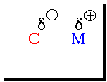
What are organometallic compounds?
A branch of coordination chemistry where the complex has one or more direct metal-carbon bonds
C is carbon atoms of an organic group or molecule
M is metal atom or ion of main group, transition, lanthanide, or actinide
The M-C bond is ionic or covalent, localized or delocalized
C always more electronegative compared to M
Defination: The leading journals of the field define an "organometallic" compound as one in which there is a direct bonding interaction (ionic or covalent, localized or delocalized) between one or more carbon atoms of an organic group or molecule and a main group, transition, lanthanide, or actinide metal atom (or atoms).
According to this definition, metal carbides (M=C), metal carbonyls (M-CO), cyanide complex (M-CN) should not be orgsanometallic compound, since here C are from inorganic moity, CO and CN⁻.
But in broad sence M-CO & M-CN complexes are consider as a part of organometallic compound.
In a broad sense, organic derivatives of the metalloids & non metals such as boron, silicon, arsenic, tellurium also are included in this definition. Thus organoborons, organosilicons etc constitute an important fragment of organometallics
[Ti(OR)₄], or [Co(acac)₃] are not organometallic compound, since there is no direct M-C bond.

Slide 3
Application of Organometallic compounds
As synthetic reagents
Grignard reagents
Used widely in organic synthesis
As Catalysts
Many synthetic reactions like hydrogenetion, polymerisation, hydroformylation etc.
Ziegler Natta Catalyst [TiCl₄ + (CH₃CH₂)₃Al] used as polymerisation of olefin
Wilkinson catalyst[ (PPh₃)₃RhCl], for hydrogenation of alkene
Zeise’s salt is the first recorded ex. In the organometallic chemistry (1827-31) a case of serendipity, means accidentally discovered
Vit B₁₂ is an unique ex. Of organometallic comp. occuring in nature. For the determination (1948) of 3 D str. of Vit B₁₂ by X-ray crystallography, Dorothy Hodgkin was awarded the Nobel Prize in Chemistry in 1964. Though Vit B₁₂ was synthesized by Woodward in 1973.

Slide 4
Significance of the Field
Nobel prizes in Organometallic Chemistry
1908: Ehrlich [salvarsan, organoarsenic compound, syphilis]
1912: Grignard and Sabatier [Grignard reagent]
1963: Ziegler and Natta [Ziegler-Natta catalyst]
1973: Fischer and Wilkinson [sandwich compounds]
1979: Brown and Wittig [hydroboration]
1981: Hoffmann and Fukui [Woodward-Hoffman Rules]
2001: The Nobel Prize in Chemistry was divided, one half jointly to William S. Knowles and Ryoji Noyori "for their work on chirally catalysed hydrogenation reactions" and the other half to K. Barry Sharpless "for his work on chirally catalysed oxidation reactions
2005: Chauvin, Schrock and Grubbs [alkene metathesis]
2010: Heck, Negishi and Suzuki [Pd-catalyzed C-C coupling]

Slide 5
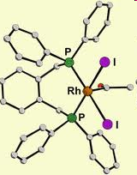
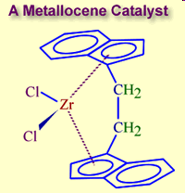
Organometallic catalysts in industrial synthesis : Three Nobel Prizes 2001, 2005 and 2010
Hydrogenation
Methanol to acetic acid process
Olefin polymerization and oligomerization

Slide 6
History of Organometallic compounds
In 1760, The first Organometallic compound
As₂O₃ + CH₃CO₂K → [(CH₃)₂As]₂O

Slide 7
Classification of organometallic compounds on the basis of bond type (M-C)
Ionic compounds:
Ionic bonding
Highly electropositive metals form trhis type bonding
Soluble in polar solvents
The examples are: Na⁺CH₃⁻, Na⁺ Ph₃C⁻, Ca²⁺(C₅H₅)⁻₂, Na⁺(C₅H₅) etc.
Stability of such compounds depends on the stability of the carbanionwhich are generally stabilized through delocalization. In fact, Ph₃C⁻is stabilized through the charge delocalizatio over the three phenyl rings. (C₅H₅ )⁻attains the aromaticity (4n+ 2 rule, 6 $π$electrons) to earn the stability
2. Metal-carbon $σ$-bonded compounds: In this type of compounds, 2c-2e M-C bonds are formed. But due to the electronegativity difference, a partial ionic character is developed in the metal carbon bond.
The examples are Grignard reagent (RMgX), Be(CH₃)₂, Si(CH₃)_{4,} W(CH₃)_{6,}Me₃SnX, Pb(Et)₄, Zn(R)₂, (R = Me, Et), etc. F. A. Victor Grignard was awarded the Nobel Prize in Chemistry in 1912 for synthesis of Grignard reagent.
It may be noted that the simple $σ$-bonded organometallics of transition metals are very much unstable.

Slide 8
Classification of organometallic compounds on the basis of bond type
3. Nonclassically bonded organometallics:
Bonding is different from conventional 2c-2e bond
In some compounds of Li, Be, Mg & Al may act as the bridging groups between the metal centres. In such cases, instead of the normal 2c-2e M-C bonds, the electron deficient multicentered M-C bonds may be formed.
The examples are: [Li₄(CH₃)₄], (4c-2e bond): [Be(CH₃)₂]_{n}- (polymeric form) (3c-2e bond), (AIR₃)₂, dimeric form (3c-2e bond), etc.
4. Metal-carbon bond having both the $σ$- and $π$- bonding character: When the ligand (e.g. CO) can act as a$π$-acid ligand (according to Lewis acid-base concept), in addition to the $σ$-donation by the ligand, there is a $π$-back bonding (i.e. metal to ligand) by using the vacant orbital on the C-centre of the ligand. This$π$ -bonding and $σ$-bonding act in a synergistic fashion to stabilize the metal-carbon bond.

Slide 9
Classification of organometallic compounds on the basis of bond type
5. Metal-carbon bonding formed by the $π$-electron of some unsaturated organic moieties: The $π$-electron clouds of the unsaturated organic molecular species such as alkene (>C=C<), alkyne (-C$≡$C-), butadiene (C₄H₆), cyclobutadiene (C₄H₄), cyclopentadienyl anion (C₅H₅)⁻, benzene (C₆H₆), alkyl anion, norbornediene, tropyliumcation, cyclooctatetraene, etc. can participate in bonding with the metal centre. In such cases, all the available $π$-electrons or a portion of the unsaturated skeleton may participate in bonding. The number of C-atoms formally gets bound to the metal centre is expressed in terms of haptonomenclature ($ηn$).
The examples are: Ziese’s salt, Ferrocene,η¹-R, η¹-Ar, η¹-allyl, $η2$-C₂H₄; $η$³-C₃H₅⁻(i.e. $η$³-allyl); $η4$-C₄H₆(i.e. $η4$-butadiene); $η4$-C₄H₄(i.e. $η4$-cyclobutadiene); $η5$-C₅H₅⁻(i.e. $η5$-cyclopentadienyl or $η5$-Cp); $η5$-C₅H₇⁻(i.e. $η5$-pentadienyl); $η6$-C₆H₆($η6$-benzene); $η7$-C₇H₇⁺(i.e. $η7$-tropylium); $η6$-C₇H₈(i.e. $η6$cycloheptatriene); η⁸-C₈H₈$, η6$-C₈H₈ (i.e$η6$-cyclooctatetraene or $η6$-cot); $η4$-C₈H₈ (i.e$η4$-cyclooctatetraene or $η4$-cot), η²-C₆₀, η⁵-R₅C₆₀.
Here it is worth mentioning that the above mentioned unsaturated organic molecular species can act as the $π$-acid ligands by using their vacant $π$*-MOs into which the metal centre can push the electron density.

Slide 10
Concept of hapticity ($ηn$) of organic ligands
Hapticity is the coordination of a ligand to a metal center via an uninterrupted and contiguous series of atoms. The hapticity of a ligand is described with the Greek letter η('eta’)
The number of C-atoms formally gets bound to the metal centre is expressed in terms of haptonomenclature ($ηn$), numerical superscript ‘n’ is number of carbon atom bonded to metal or the number of atoms of the ligand which are within bonding distance of the metal atom.n can have value from 1-8
Denticity ($κ$):Polydentate ligands coordinate via multiple coordination sites within the ligand. In this case the coordinating atoms are identified using the κ-notation, as for example [PtCl2(edta)]⁴⁻: dichloro [(1,2-ethanediaminetetraacetato $κ$N,$κ$O] platinate(4-)
Though EDTA has 6 potential donor center (2 N & 4 O atom), here EDTA is coordinating to Pt(II) through 1 N & 1 O

Slide 11
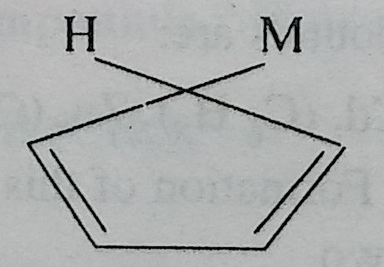
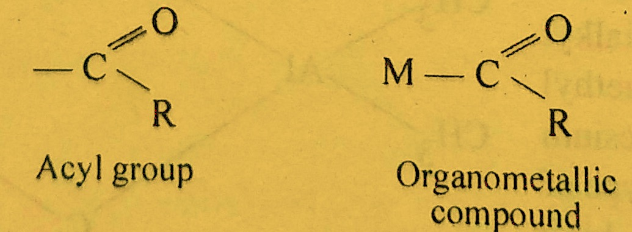
Classification of organic ligands on the basis of C atoms involved in bonding to the metal atom, i. e. hapticity
One carbon bonded ligands: These are the molecules in which the carbon atom of the ligand is bonded directly to the metal atom. Such ligands are also called monohapto ligands ($η1$, one electron donors). For example, -CH₃group attaches by a single M-C bond. These ligands are of the following different types:
Hydrocarbon ligands: These include alkyl (-CH₃, η¹-R), aryl (-C6H5,η¹-Ar), (-CR=CR₂), $σ$-cyclopentadienyl(-C5H5), alkynyl (-C$≡$CR) group.
For example, cyclopentadiene (C5H5) combines with alkali metals to form ($σ$- C5H5)M compound as shown below:
(ii) Acyl ligands: These include acyl group which involves direct bonding of the acyl group(-COR) to a metal atom. These compounds are formed by transition metals only
(One carbon bonded cyclopentadienyl compound)

Slide 12
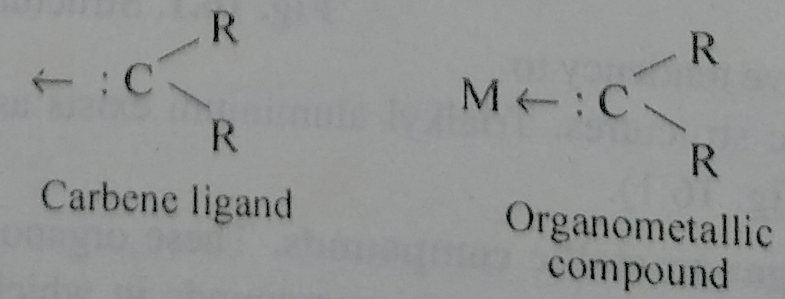
Classification of organic ligands on the basios of C atoms involved in bonding to the metal atom, i. e. hapticity
(iii) Carbene ligands: These involve the direct metal carbon bond of the carbon atom of carbene (alkylidene) to a metal atom.
2. Two carbon bonded ligands: These are the molecules in which two carbon atoms of the ligands are bonded to the metal atom. These are called dihapto ($η2$) ligands (or two-electron donors).
Examples are alkenes or alkynes in which both the carbon atoms at each end of the multiple bond are involved in forming the metal-carbon bonds. The bonding in these ligands is indicated either by two dotted lines to the participating carbon atom or a single solid line from the centre of the participating carbon atoms of the ligand to the metal atom.η²-C₂R₄

Slide 13
Classification of organic ligands on the basios of C atoms involved in bonding to the metal atom, i. e. hapticity
3. Three carbon bonded ligands: These are the molecules in which three carbon atoms of the ligands are bonded to the metal atom. These are called trihapto ligands ($η3$).
Examples are allyl group (-C₃H₅) known as $π$-allyl ligands as shown below. These may be distinguished from $σ$-allylcomplexes in which the allyl group is bonded through one carbon atom only (monohapto).
$η$³-C₃H₅⁻ orη³-allyl &η¹-allyl
4. Four carbon bonded ligands: These ligands have four carbon atoms which may be bonded to the metal atom. Therefore, these are called tetrahapto ($η4,$4-electron donors). These include acyclic ligands such as 1,3-butadiene and cyclic ligands such as cyclobutadiene.
$η4$-C₄H₆

Slide 14
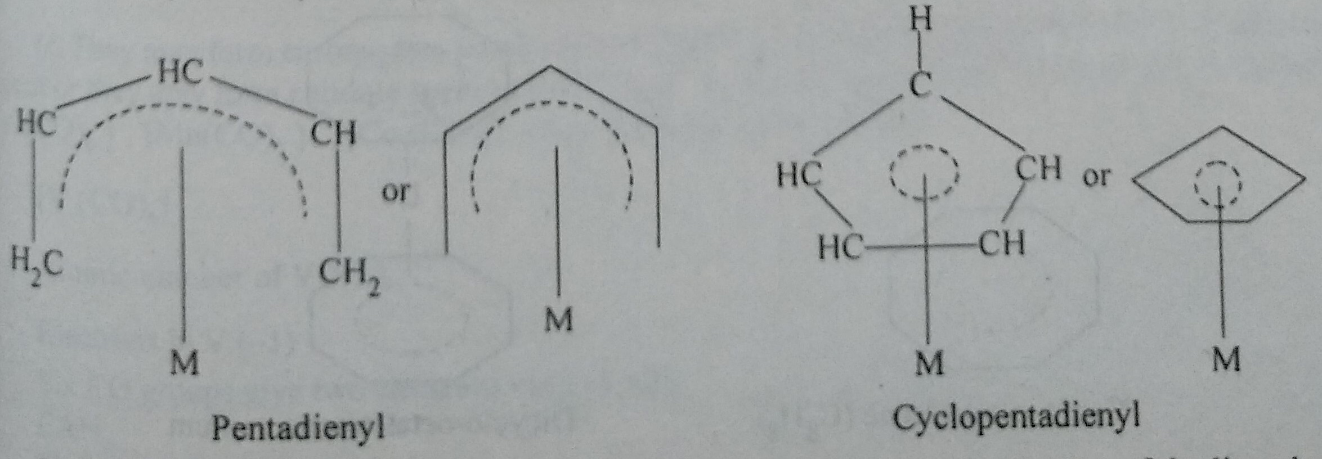
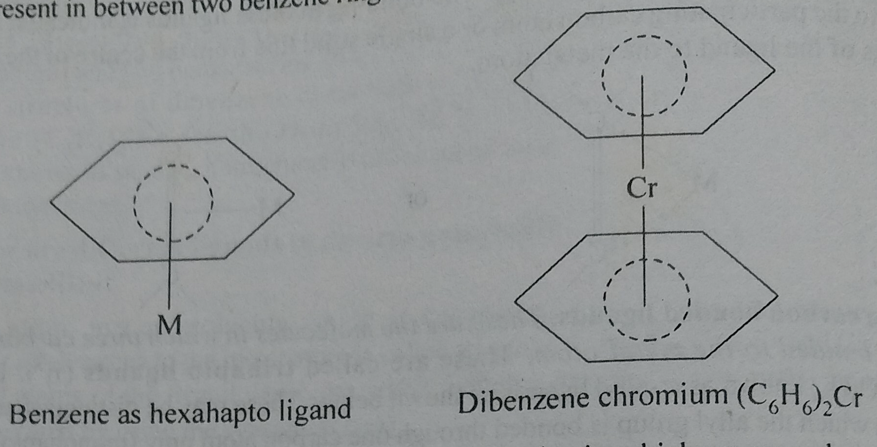
Classification of organic ligands on the basios of C atoms involved in bonding to the metal atom, i. e. hapticity
5. Five carbon bonded ligands: These ligands are molecules in which five carbon atoms of the ligands are bonded to the metal atom. These are called pentahapto($η5$) ligands. Examples are acyclic dienyls and cyclic dienyls (e.g., cyclopentadienyl).$η5$-C₅H₇⁻(i.e. $η5$-pentadienyl); $η5$-C₅H₆⁻ or η⁵-Cp
6. Six carbon bonded ligands: The molecules in which six carbon atoms of the ligand are bonded to the metal atom. The common example is benzene. The common example of an organometallic compound is dibenzene chromium (C₆H₆)₂Cr. This is also a sandwich compound in which Cr atom is present in between two benzene rings.η⁶-C₆H₆

Slide 15
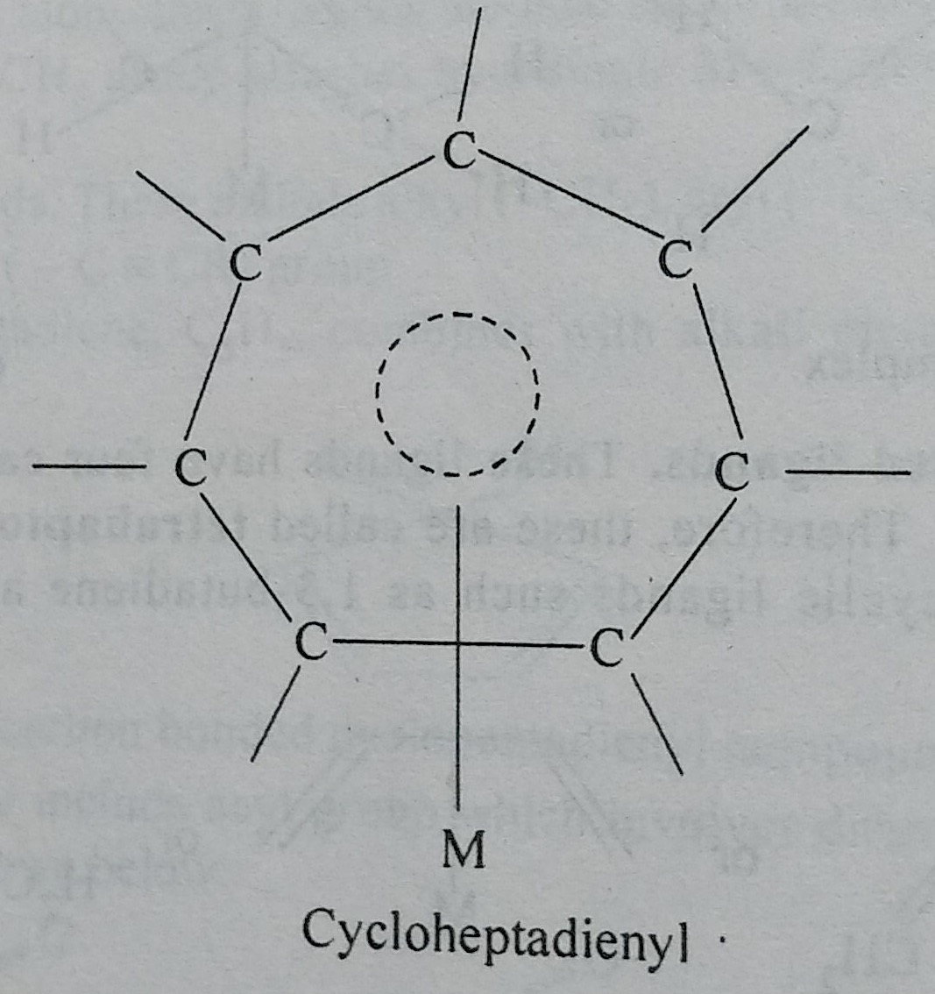
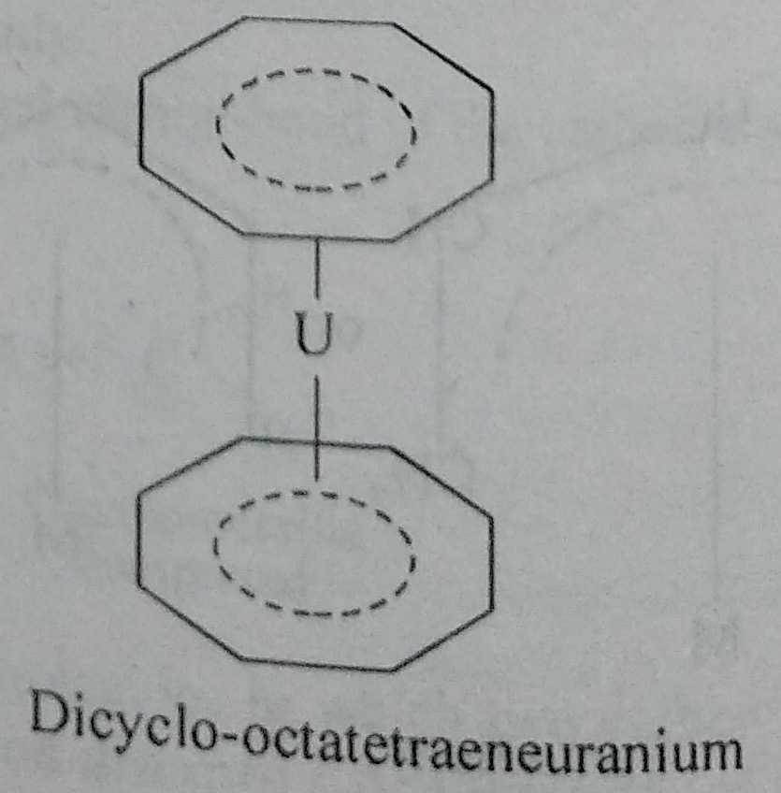
Classification of organic ligands on the basios of C atoms involved in bonding to the metal atom, i. e. hapticity
7. Seven carbon bonded ligands: These are molecules in which seven carbon atoms act as electron donors by participating all the seven carbon atoms in bond formation. The common example is cycloheptadienyl$η7$-C₇H₇⁺(i.e. $η7$-tropylium)
8. Eight carbon bonded ligands: These are molecules in which eight carbon atoms are involved in bond formation. These are also called octahapto ($η5$) ligands. The common example is cyclo-octatetraene(η⁸-C₈H₈). The common example of the complex is U(C₈H₈)₂

Slide 16
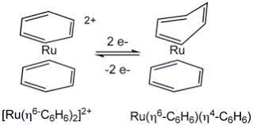
The hapticity of a ligand can change in the course of a reaction. e.g. in a redox reaction

Slide 17
18-electron and 16-electron rules (pictorial MO approach)
In 1927 developed by NevilSidgwick
The rule states that “A stable TM complex is formed when the sum of vallence-electrons of TM + donated ligand electrons +charge on complex = 18.”
18 e compounds are stable
17 e⁻ comp. are strong oxidising agent: 17 e (M^{n})+ e⁻ $→$18 e (M^{n-1})
19 e⁻comp. are strong reducing agent: 19 e (M^{n})-e$→$18 e (M^{n-1} )
Compound with 17 & 19 e are paramagnetic while compounds with 18 e are diamagnetic
The symbol μ indicates bridging normally we have μ₂ and rarelyμ₃bridging
Examples: μ₂-CO, μ₃-CO, μ₂-CH₃, μ₂-H, μ₂-Cl, , μ₃-Cl, μ₂-OR, μ₂-PR₂, μ₂-NR₂

Slide 18
18-electron and 16-electron rules
Transition Metals
Total No. of vallence e:3 4 5 6 7 8 9 10 11 12
3d: Sc Ti V Cr Mn Fe Co Ni Cu Zn
4d: Y Zr Nb Mo Tc Ru Rh Pd Ag Cd
5d: Ta W Re Os Ir Pt Au Hg
18 e rule: 3d TM carbonyl compleses mostly obey 18 e rule
16 e rule: d⁸ square planner complexes of 4d & 5d transition series of group 9, i.e. Rh(I), Ir (I), and group 10 , i.e. Pd(II), Pt (II), & Cu(III) are 16 e compounds
Ni (28): 1S² 2S² 2p⁶ 3S² 3p⁶ 4S² 3d⁸: it is better to promote 4S e to 3d, Therefore Ni (0) is d¹⁰ Cu (I), Ag (I), Au (I) & Zn⁺², Cd⁺², Hg+² is d¹⁰

Slide 19
18-electron and 16-electron rules
V(CO)₆ (17 Valence Electron), Cr(CO)₆ (18 VE), Mn(CO)₅ (17 e), Fe(CO)₅ (18e), Co(CO)₄ (17 e), Ni(CO)₄ (18e)
Mononuclear carbonyls with even atomic number obey 18 e rule
Mononuclear carbonyls with odd atomic number do not obey 18 e rule. Mn(CO)₅ (17 e),&Co(CO)₄(17 e) are hypothetical carbonyls
V (23), Cr (24), Mn(25), Fe (26), Co (27), Ni (28)
2 Mn(CO)₅ $→$(CO)₅Mn-Mn(CO)₅
HMn(CO)₅, ClMn(CO)_{5,} CH₃Mn(CO)₅

Slide 20
Easy way to remember ligand electron contribution for neutral atom counting method
Electron contribution
Neutral terminal : CO, PR₃, NR₃ 2 electrons
Anionic terminal : X-, H-, R-, Ar-, R₂N-, R₂P-, RO- 1 electron
Hapto ligands : η²-C₂R₄ η²-C₂R₂, η⁴-C₂R₂ ,η¹-allyl,
η³-allyl, η⁴- Cb, η⁵-Cp, η⁶-C₆H₆
η⁷-C₇H₇ η⁸-C₈H₈ η²-C₆₀, η⁵-R₅C₆₀ same as hapticity
bridging neutral μ₂-CO, μ₃-CO 2 electrons
Bridging anionic μ₂-CH₃, μ₂-H ( no lone pairs) 1 electron
Bridging anionic μ₂-Cl, , μ₂⁻OR, μ₂-PR₂, μ₂-NR₂ 3 electrons
(with 1 lone pair)
μ₃-Cl( 2 l.p) 5 electrons
Bridging alkyne 4 electrons
NO linear 3 electrons
NO bent ( l. p on nitrogen) 1 electron
Carbene M=C 2 electron
Carbyne M≡C 3 electron

Slide 21
Methods of counting: Neutral atom method & Oxidation state method
Ligand | Neutral atom | Oxidation state |  | Ligand | Neutral atom | Oxidation state
 |  | Electron contribution | Formal charge |  |  | Electron contribution | Formal charge
Carbonyl (M–CO) | 2 | 2 | 0 | Halogen ( M–X) | 1 | 2 | –1
Phosphine (M–PR₃) | 2 | 2 | 0 | Alkyl (M–R) | 1 | 2 | –1
Amine (M–NR₃ ) | 2 | 2 | 0 | Aryl (M–Ar) | 1 | 2 | –1
Amide (M–NR₂ ) | 1 | 2 | –1 | acyl (M–C(O)–R | 1 | 2 | –1
Hydrogen (M–H) | 1 | 2 | –1 | η¹-cyclopentadienyl | 1 | 2 | –1
Alkene (sidewise) η²- | 2 | 2 | 0 | η¹-allyl | 1 | 2 | –1
Alkyne (sidewise) η²- | 2 | 2 | 0 | η³-allyl | 3 | 4 | –1
η²-C₆₀ | 2 | 2 | 0 | η⁵-cyclopentadienyl | 5 | 6 | –1
Nitrosyl bent | 1 | 2 | –1 | η⁶-benzene | 6 | 6 | 0
Nitrosyl linear | 3 | 2 | +1 | η⁷-cycloheptatrienyl | 7 | 6 | +1
Carbene (M=CR₂) | 2 | 4 | –2 | Carbyne (M≡CR) | 3 | 6 | –3
Alkoxide (M–OR) | 1 | 2 | –1 | Thiolate (M–SR) | 1 | 2 | –1
μ-CO (M–(CO)–M) | 2 | 2 | 0 | μ-H | 1 | 2 | –1
μ-alkyne | 4 | 4 | 0 | μ-X (M–X–M) X = halogen | 3 | 4 | –1
μ-alkyl | 1 | 2 | –1 | μ-amido (M–(NR₂)–M | 3 | 4 | –1
μ-phosphido (M–(PR₂)–M | 3 | 4 | –1 | μ-alkoxide (M–(OR)–M | 3 | 4 | –1

Slide 22
Applications of 18-electron rule to metal carbonyls
There are 2 methods of e counting
Neutral atom method: Metal is taken as in zero oxidation state for counting purpose
Oxidation state method: We first arrive at the oxidation state of the metal by considering the number of anionic ligands present and overall charge of the complex
For neutral ligand both method gives same result
Suggestion: Focus on one counting method till you are confident
Neutral atom method Oxidation state method
Mn₂(CO)₁₀
Mn⁰ (4S² 3d⁵): 7 VE
5 CO: 10 VE
1 M-M bond: 1 VE
Total 7+10+1 = 18 VE

Slide 23
Applications of 18-electron rule to metal carbonyls
Neutral atom method Oxidation state method
2. CH₃Mn(CO)₅ $⇋$ CH₃.(radical)+ Mn(CO)₅. (homolytic cleavage)or
CH₃⁻(anion)+ Mn(CO)₅⁺ (heterolytic cleavage)
Mn⁰(4S²3d⁵): 7 VEMn⁺: 6 VE
CH₃. (radical): 1 VE CH₃⁻ (anion):2 VE
5 CO: 10 VE5 CO: 10 VE
Total 7+1+10 = 18 VE Total 6+2+10 = 18 VE

Slide 24
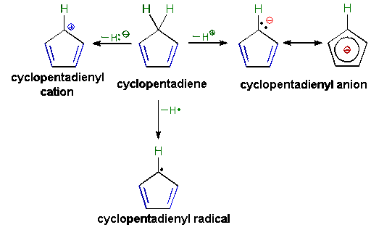
Applications of 18-electron rule to metal carbonyls
heterolytic cleavage
(C₅H₅⁻)
C₅H₆
homolytic cleavage
(C₅H₅.)

Slide 25
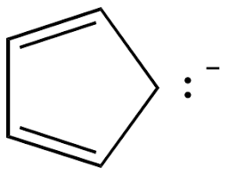
Applications of 18-electron rule to metal carbonyls
Neutral atom method Oxidation state method
2. Ferrocene:Fe(C₅H₅)₂
Fe⁰ (4S² 3d⁶): 8e Fe⁺²: 6e
2 (C₅H₅). (radical): 2x5= 10e 2 (C₅H₅)⁻ (anion): 2x6= 12e
Total 10+8 = 18 e Total 10+8 = 18 e
3. η⁵CpFe(CO)₂Cl:
8(Fe⁰) +5+ (2x2)+1= 18e 6(Fe⁺²) + 6 (Cp)+ (2x2)+2(Cl-)= 18e
4. [Cp₂Co)⁺:
9 (Co⁰) +(5x2) + -1 (for +1)= 18e 6(Co⁺³) + (6x2) = 18e
5. Na₂Fe(CO)n: 2Na⁺ +[Fe(CO)n]²⁻
8(Fe⁰) +(nx2)+2 (for 2-)= 18e, so n=46+Fe(+2)6+ (2x2)+2(Cl-)= 18e

Slide 26
Applications of 18-electron rule to metal carbonyls
Neutral atom method Oxidation state method
6. MnBr(CO)n:
7 (Mn⁰) +1 (for Br.)+ (nx2) = 18e, So n=5
7. Find M, in the stable complex [CpM(CO)₃]₂:
M (M⁰) +5 (Cp)+ (3x2)+1(for M-M bond) = 18e, So M=18-12 = 6, i.e. M= Cr or Mo or W
13. Find the nature of V(CO)6, whether it is oxidising or reducing agent & its magnetic properties.
V(CO)6 is 17 e system. So for (17e+e$→$ 18e, V(CO)6 gets reduce) it is acting as strong oxidising reagent. 1 unpaired e, so paramagnetic in nature. (3p⁶ 4S² 3d⁹)
14. Find the nature & magnetic property of (Cp)₂Co
9 (Co⁰) + (5x2) = 19e. So for (19e - e$→$18e,it gets oxidize) it is acting as strong reducing reagent. 1 unpaired e, so paramagnetic in nature. (3p⁶ 4S² 3d⁹)

Slide 27
Applications of 18-electron rule to metal carbonyls
15
16

Slide 28
Applications of 18-electron rule to metal nitrosyls, cyanides
Neutral atom method Oxidation state method
1. [Co⁻$($CO)₃(NO⁺)]:
9(Co⁰) +6 (for 3 CO)+ 3 (for NO)= 18e;
10(Co⁻¹) +6 (for 3 CO)+ 2 (for NO⁺)= 18e
2. [Fe⁻²$($CO)₂(NO⁺)₂]:
8(Fe⁰) +4 (for 2 CO)+ (2x3)(for 2 NO)= 18e;
10(Fe⁻²) +4 (for 2 CO)+ (2x2)(for 2 NO⁺)= 18
3. [Fe⁻² (NO⁺)₂(PR₃)₂]:
8(Fe⁰) +4 (for 2 PR₃)+ (2x3)(for 2 NO, Neutral NO 3 e donor)= 18e;
10(Fe⁻²) +4 (for 2 PR₃)+ (2x2)(for 2 NO⁺,NO⁺ 2e donor)= 18

Slide 29
Applications of 18-electron rule to metal carbonyls, nitrosyls, cyanides
Neutral atom method Oxidation state method
4. [Mn⁻³$($CO)(NO⁺)₃]:
7(Mn⁰) +2 (for CO)+ (3x3)(for 3 NO)= 18e;
10(Mn⁻³) +2 (for CO)+ (3x2)(for 3 NO⁺)= 18e

Slide 30
Reference
Ashim K Das & Mahua Das, Fundamental Concept of Inorganic Chemistry, CBC Publishers & Distributors, Volume 6, First Edition: 2014
Ashim K Das & Mahua Das, Fundamental Concept of Inorganic Chemistry, CBC Publishers & Distributors, Volume 3, First Edition: 2014
Wahid U. Malik, G. D. Tuli & R. D. Madan, Selected topics in inorganic chemistry, S. Chand & Company Ltd, first edition
Christoph Elschenbroich, Organometallics, 3rd Completely Revised and Extended Edition, Wiley-VCH Verlag GmbH & Co. KGaA, Weinheim, Germany, 2006
Robert H Crabtree, The Organometallic Chemistry of the Transition Metals, 4th Edition, John Wiley & Sons, Inc., Hoboken, New Jersey, 2005
B D Gupta and A J Elias, Basic Organometallic Chemistry, University Press (India) Pvt Ltd., 2010

Slide 31
Thank you

